Slide 1
ROC Curves & Confusion Matrix Based on: “Model Assessment with ROC Curves” by Lutz Hamel, Department of Computer Science and Statistics University of Rhode Island USA
Prepared & presented by: Mohammad Rawashdeh.
Advisor: Prof. Anca Ralescu.
Machine Learning and Computational Intelligence Laboratory.

Slide 2
Task
Classification model assessment

Slide 3
Binary Classification: +1/-1
Four possible situations with respect to observed-known and predicted:
True Positive. (hit)
True Negative. (correct reject)
False Positive. (false alarm)
False Negative. (miss)

Slide 4
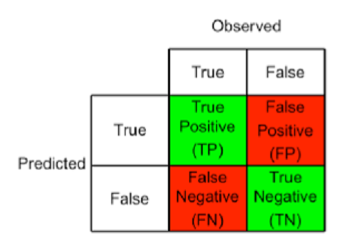
Confusion Matrix
+1
-1
Correct classifications
Errors
Note:
(TP + TN) + (FP + FN) = Correct classifications + Errors = # instances.

Slide 5
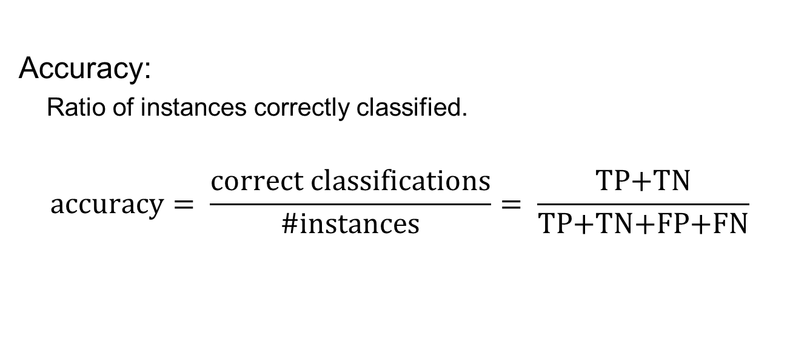
Measures Based on Confusion Matrix
Accuracy:
Ratio of instances correctly classified.
$$\text{accuracy}= \frac{\text{correct} \text{classifications}}{\text{\#}\text{instances}}= \frac{\text{TP}\text{+}\text{TN}}{\text{TP}\text{+}\text{TN}\text{+}\text{FP}\text{+}\text{FN}}$$

Slide 6

Measures Based on Confusion Matrix
Precision:
Accuracy with respect to instances predicted as positives.
$$\text{precision}= \frac{\text{TP}}{\text{TP}\text{ + }\text{FP}}$$

Slide 7

Measures Based on Confusion Matrix
Recall:
Ratio of positive instances that are correctly predicted.
$$\text{recall}= \frac{\text{TP}}{\text{TP}\text{ + }\text{FN}}$$

Slide 8
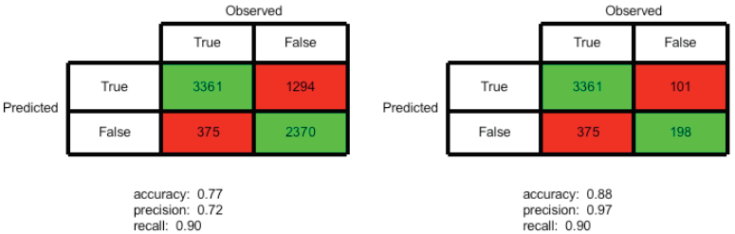
Disadvantages
precision
recall
resampled: smaller
Accuracy-precision-recall:
Depend on the choice of test set.
Sensitive to class skew.
They only produce a scalar as an assessment of the model.

Slide 9
ROC Curves
They are independent of the test data, at least with respect to class skew.
Requires instance prediction-confidence for its construction:
Naïve Bayes, ANN, SVM and many others, establish some ranking about assigning instance to each class, then form a decision-prediction.
Each ROC point is given by
(false positive rate, true positive rate)

Slide 10
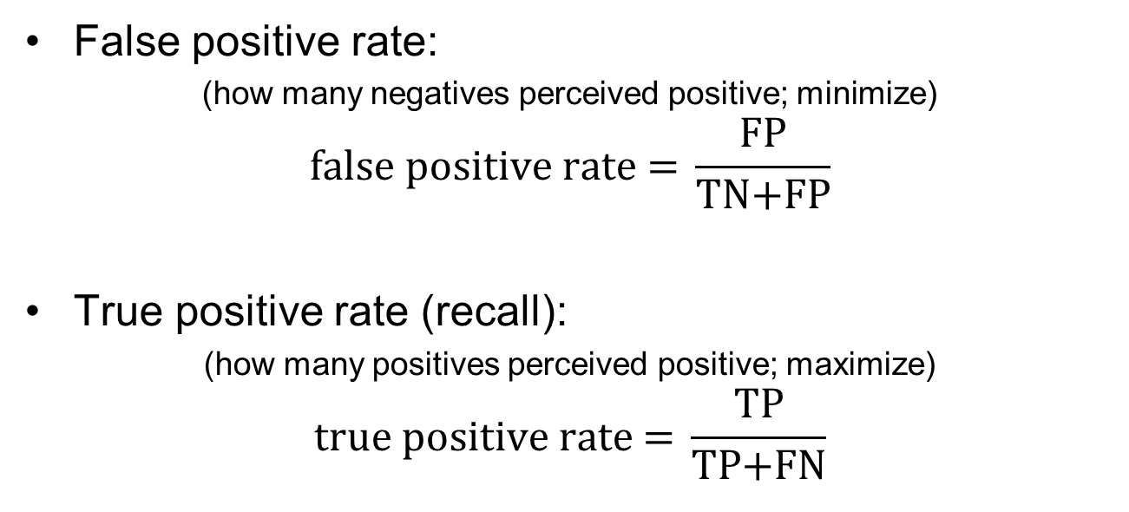
ROC Curves: FPR/TPR
False positive rate:
(how many negatives perceived positive; minimize)
$$\text{false} \text{positive} \text{rate}\text{ = }\frac{\text{FP}}{\text{TN}\text{+}\text{FP}}$$
True positive rate (recall):
(how many positives perceived positive; maximize)
$$\text{true} \text{positive} \text{rate}\text{ = }\frac{\text{T}\text{P}}{\text{T}\text{P}\text{+}\text{FN}}$$

Slide 11
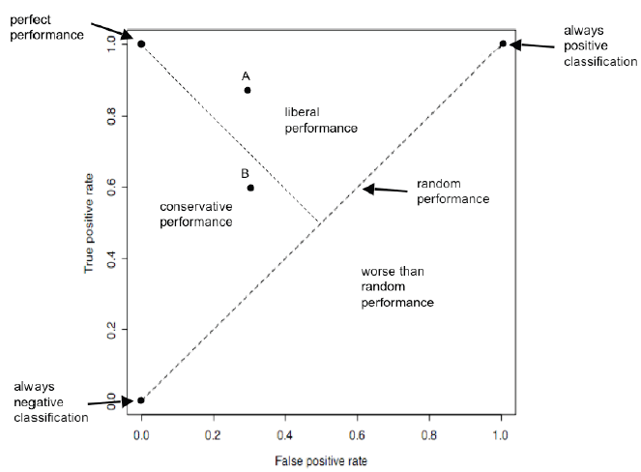
ROC Graph: Regions

Slide 12
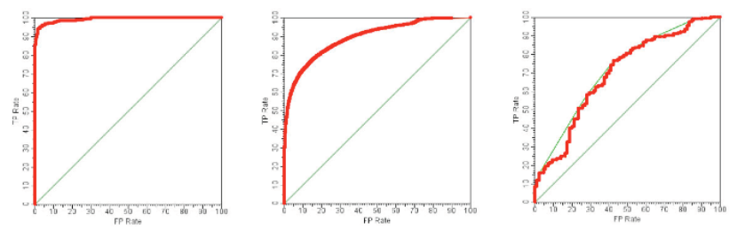
ROC Curves: Examples
Almost perfect classifier
Reasonable classifier
Poor classifier

Slide 13
ROC Curves: Construction
Given confidence in positive predictions:
Normalize, so all confidence values are between 0,1.
Enumerate different decision thresholds and find ROC points in the process.

Slide 14
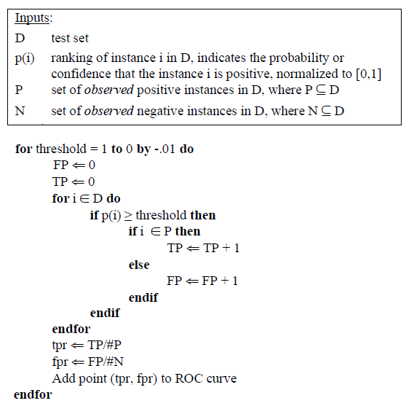
ROC Curves: Construction

Slide 15
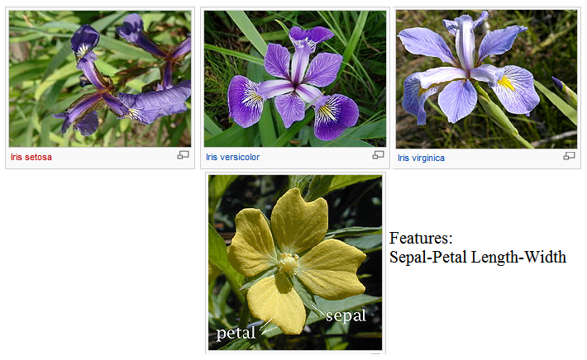
Case Study: Iris Dataset
(150 flower samples, 3 species, 4 features)

Slide 16
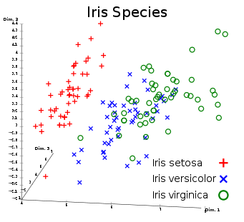

Slide 17
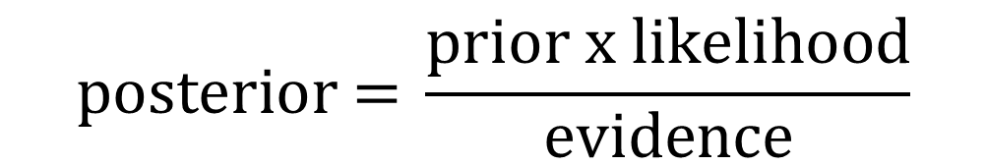
Iris Dataset: Naïve Bayes classification
Problem1: Versicolor (+1) vs. Setosa (-1)
Problem2: Versicolor (+1) vs. Virginica (-1)
$$\text{posterior}\text{ = }\frac{\text{prior} \text{x} \text{likelihood}}{\text{evidence}}$$

Slide 20
Thank You!
Questions?

